Slide 1
안드로이드 실무 9주차 과제
1901055 정시철

Slide 2
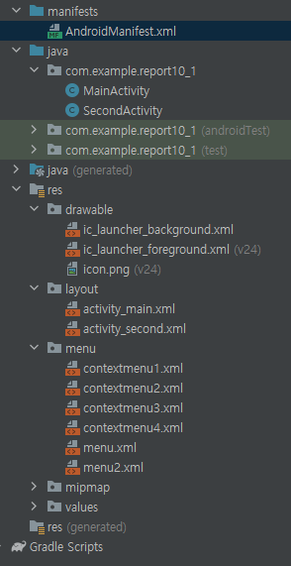
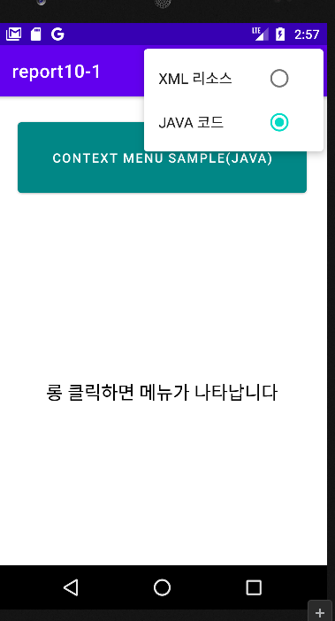
Report 1 Menu 응용
<?xml version="1.0" encoding="utf-8"?> <LinearLayout xmlns:android="http://schemas.android.com/apk/res/android" xmlns:tools="http://schemas.android.com/tools" android:layout_width="match_parent" android:layout_height="match_parent" tools:context=".MainActivity" android:orientation="vertical"> <Button android:layout_width="match_parent" android:layout_height="40pt" android:layout_margin="10pt" android:text="Context Menu Sample(XML)" android:gravity="center" android:layout_gravity="top" android:textColor="@color/white" android:backgroundTint="@color/teal_700"/> <TextView android:id="@+id/textView" android:layout_width="match_parent" android:layout_height="match_parent" android:gravity="center" android:text="롱 클릭하면 메뉴가 나타납니다" android:textColor="@color/black" android:textSize="20dp" /> </LinearLayout>
<?xml version="1.0" encoding="utf-8"?> <LinearLayout xmlns:android="http://schemas.android.com/apk/res/android" xmlns:tools="http://schemas.android.com/tools" android:layout_width="match_parent" android:layout_height="match_parent" tools:context=".SecondActivity" android:orientation="vertical"> <Button android:layout_width="match_parent" android:layout_height="40pt" android:layout_margin="10pt" android:text="Context Menu Sample(JAVA)" android:gravity="center" android:layout_gravity="top" android:textColor="@color/white" android:backgroundTint="@color/teal_700"/> <TextView android:id="@+id/textView" android:layout_width="match_parent" android:layout_height="match_parent" android:gravity="center" android:text="롱 클릭하면 메뉴가 나타납니다" android:textColor="@color/black" android:textSize="20dp" /> </LinearLayout>
<?xml version="1.0" encoding="utf-8"?> <menu xmlns:android="http://schemas.android.com/apk/res/android"> <group android:checkableBehavior="single" android:enabled="true"> <item android:id="@+id/black" android:checked="true" android:title="검정" /> <item android:id="@+id/red" android:title="빨강" /> <item android:id="@+id/green" android:title="녹색" /> <item android:id="@+id/blue" android:title="파랑" /> </group> </menu>
<?xml version="1.0" encoding="utf-8"?> <menu xmlns:android="http://schemas.android.com/apk/res/android"> <group android:checkableBehavior="single" android:enabled="true"> <item android:id="@+id/black" android:title="검정" /> <item android:id="@+id/red" android:checked="true" android:title="빨강" /> <item android:id="@+id/green" android:title="녹색" /> <item android:id="@+id/blue" android:title="파랑" /> </group> </menu>
<?xml version="1.0" encoding="utf-8"?> <menu xmlns:android="http://schemas.android.com/apk/res/android"> <group android:checkableBehavior="single" android:enabled="true"> <item android:id="@+id/black" android:title="검정" /> <item android:id="@+id/red" android:title="빨강" /> <item android:id="@+id/green" android:checked="true" android:title="녹색" /> <item android:id="@+id/blue" android:title="파랑" /> </group> </menu>
메인
세컨드
<?xml version="1.0" encoding="utf-8"?> <menu xmlns:android="http://schemas.android.com/apk/res/android"> <group android:checkableBehavior="single" android:enabled="true"> <item android:id="@+id/black" android:title="검정" /> <item android:id="@+id/red" android:title="빨강" /> <item android:id="@+id/green" android:title="녹색" /> <item android:id="@+id/blue" android:checked="true" android:title="파랑" /> </group> </menu>
package com.example.report10_1; import androidx.annotation.NonNull; import androidx.appcompat.app.AppCompatActivity; import android.content.Intent; import android.graphics.Color; import android.os.Bundle; import android.view.ContextMenu; import android.view.Menu; import android.view.MenuInflater; import android.view.MenuItem; import android.view.View; import android.widget.TextView; public class MainActivity extends AppCompatActivity { TextView textView; int index = 0; boolean type = true; int[] id = new int[]{R.menu.contextmenu1, R.menu.contextmenu2, R.menu.contextmenu3, R.menu.contextmenu4}; @Override public boolean onCreateOptionsMenu(Menu menu) { MenuInflater inflater = getMenuInflater(); inflater.inflate(R.menu.menu,menu); return super.onCreateOptionsMenu(menu); } @Override public boolean onOptionsItemSelected(@NonNull MenuItem item) { if (item.getItemId()==R.id.javac){ Intent intent = new Intent(MainActivity.this,SecondActivity.class); startActivity(intent);} return super.onOptionsItemSelected(item); } @Override protected void onCreate(Bundle savedInstanceState) { super.onCreate(savedInstanceState); setContentView(R.layout.activity_main); textView = findViewById(R.id.textView); registerForContextMenu(textView); } @Override public void onCreateContextMenu(ContextMenu menu, View v, ContextMenu.ContextMenuInfo menuInfo) { MenuInflater menuInflater = getMenuInflater(); menu.setHeaderTitle("글자색"); menu.setHeaderIcon(R.drawable.icon); menuInflater.inflate(id[index], menu); } @Override public boolean onContextItemSelected(MenuItem item) { switch (item.getItemId()) { case R.id.black: textView.setTextColor(Color.BLACK);index = 0;break; case R.id.red:// 빨강 메뉴 선택시 textView.setTextColor(Color.RED);index = 1;break; case R.id.green:// 녹색 메뉴 선택시 textView.setTextColor(Color.GREEN);index = 2;break; case R.id.blue:// 파랑 메뉴 선택시 textView.setTextColor(Color.BLUE);index = 3; } return super.onContextItemSelected(item); }}
package com.example.report10_1; import androidx.annotation.NonNull; import androidx.appcompat.app.AppCompatActivity; import android.content.ClipData; import android.content.Intent; import android.graphics.Color; import android.os.Bundle; import android.view.ContextMenu; import android.view.Menu; import android.view.MenuInflater; import android.view.MenuItem; import android.view.View; import android.widget.TextView; public class SecondActivity extends AppCompatActivity { TextView textView; int index = 1; @Override public boolean onCreateOptionsMenu(Menu menu) { MenuInflater inflater = getMenuInflater(); inflater.inflate(R.menu.menu2,menu); return super.onCreateOptionsMenu(menu); } @Override public boolean onOptionsItemSelected(@NonNull MenuItem item) { if (item.getItemId()==R.id.xmlr){ finish();} return super.onOptionsItemSelected(item); } @Override protected void onCreate(Bundle savedInstanceState) { super.onCreate(savedInstanceState); setContentView(R.layout.activity_second); textView = findViewById(R.id.textView); registerForContextMenu(textView); } @Override public void onCreateContextMenu(ContextMenu menu, View v, ContextMenu.ContextMenuInfo menuInfo) { menu.setHeaderTitle("글자색"); if (index == 1) menu.add(1, 1, 0, "검정").setChecked(true); else menu.add(1, 1, 0, "검정"); if (index == 2) menu.add(1, 2, 0, "빨강").setChecked(true); else menu.add(1, 2, 0, "빨강"); if (index == 3) menu.add(1, 3, 0, "녹색").setChecked(true); else menu.add(1, 3, 0, "녹색"); if (index == 4) menu.add(1, 4, 0, "파랑").setChecked(true); else menu.add(1, 4, 0, "파랑"); menu.setGroupCheckable(1, true, true); } @Override public boolean onContextItemSelected(MenuItem item) { switch (item.getItemId()) { case 1: textView.setTextColor(Color.BLACK);index = 1;break; case 2:// 빨강 메뉴 선택시 textView.setTextColor(Color.RED);index = 2;break; case 3:// 녹색 메뉴 선택시 textView.setTextColor(Color.GREEN);index = 3;break; case 4:// 파랑 메뉴 선택시 textView.setTextColor(Color.BLUE);index = 4; } return super.onContextItemSelected(item); }}
내용이 조금 난잡할 수 있습니다.
그냥 수업자료의 예제를 보이는 그대로 응용했습니다.
콘텍스트메뉴 4개
<?xml version="1.0" encoding="utf-8"?> <menu xmlns:android="http://schemas.android.com/apk/res/android"> <group android:checkableBehavior="single" android:enabled="true"> <item android:id="@+id/xmlr" android:checked="true" android:title="XML 리소스" /> <item android:id="@+id/javac" android:title="JAVA 코드" /> </group> </menu>
<?xml version="1.0" encoding="utf-8"?> <menu xmlns:android="http://schemas.android.com/apk/res/android"> <group android:checkableBehavior="single" android:enabled="true"> <item android:id="@+id/xmlr" android:title="XML 리소스" /> <item android:id="@+id/javac" android:checked="true" android:title="JAVA 코드" /> </group> </menu>
그냥메뉴 2개

Slide 3
Report 2 Pop메뉴

Slide 4
Report 3

